Slide 1
2014 IIHF NEW RULES WORKSHOP
Frankfurt, Germany, June 13, 2014

Slide 2
New Rules Workshop Goals
To provide the reasoning for the development of a new IIHF Rule Book
To provide the history of it’s evolution and develpment
To provide an explanation of it’s new lay out, contents and structure
To provide an overview of the housekeeping & minor rule changes
To provide the opportunity to discuss and become familiar with the major rule changes
To provide an opportunity to explain and discuss the IIHF Officiating Standard at our various events

Slide 3
The IIHF Rule Book - Evolution & Development
During the 1998/99 season the IIHF Rule book was launched with a new design and a new format where the existing rules were completely re-written
The new A5 size included coloured photographs, drawings, schematics and various coloured font
A new ‘Notes page’ opposite the ‘Rules page’ design was introduced
An ‘all-information-in-one-book’ strategy was targeted for all ages and all participants
The new version included expanded appendices for reference

Slide 4
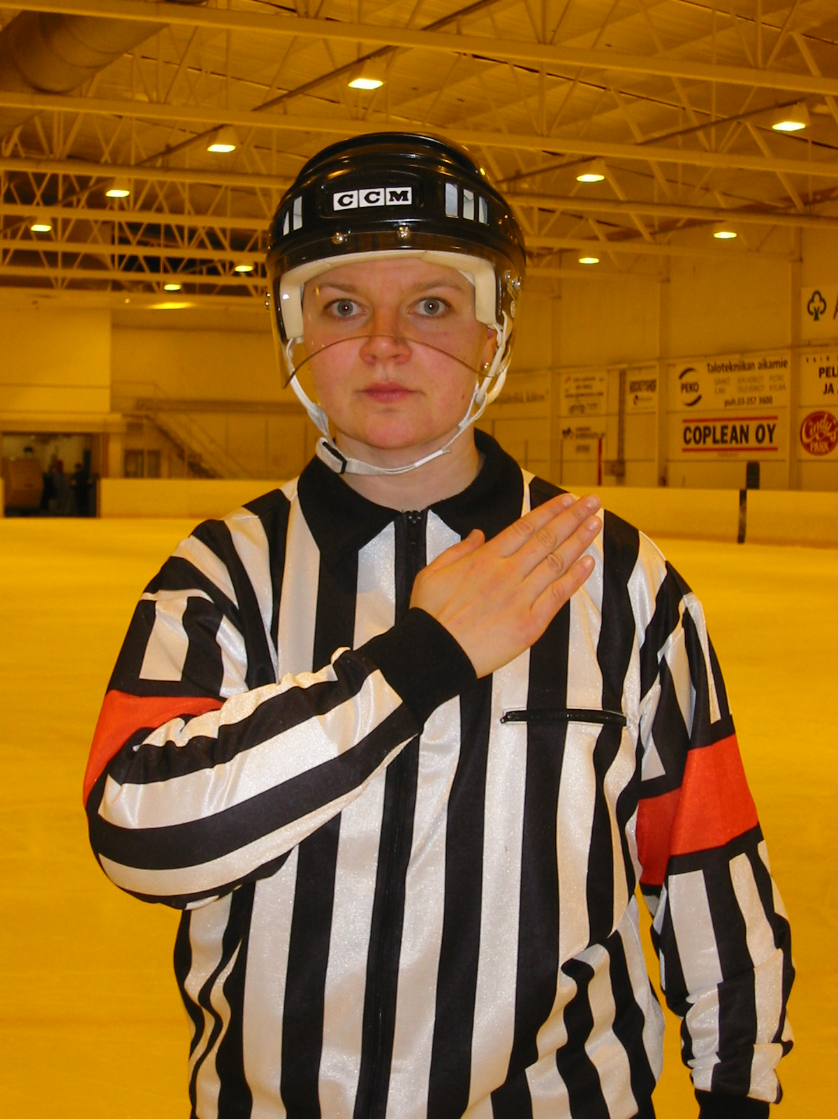
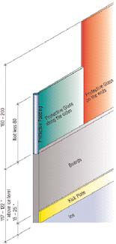
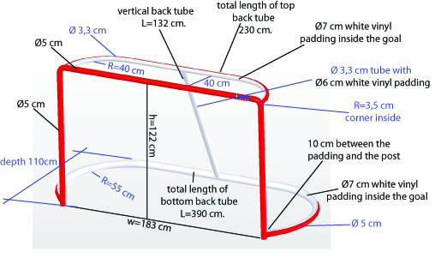
Evolution & Development

Slide 5
… in general, the current IIHF Rule Book was a good resourse. In use for 16 seasons, it has been printed in 26 different languages …

Slide 6
… but, there are drawbacks
There is a duplication of information in the contents that conflicts with other IIHF documents
Inconsistent wording and contradictions have crept into the text
The IIHF Case Book needed expanding as did rule the number and frequency of interpretation and rule bulletins distributed to the IIHF membership to clarify rules and their application
Goaltender equipment pieces that require measurement have expanded on a regular basis and greater frequency of control is required
Schematics, drawings and photos need upgrading
The current format does not lend itself to include all relevant information for explaining or applying the rules

Slide 7
The IIHF Rule Congress Summary
The development of the 2014 IIHF Rule Book was delayed
The IIHF membership approved the delay for the submission of rule proposals by one year due to late election of the current Council (September 2012) and the corresponding late announcement of IIHF Committees in January 2013
Once opened, the IIHF received 86 different rule proposals on 55 existing rules and proposals for two new ones
Of these proposals, 4 were forwarded to committees for regulation considerations, 12 were withdrawn by the proposing body, 51 were determined as housekeeping and minor rule changes while 19 were targeted as major rule change proposals or ‘game changers’

Slide 8
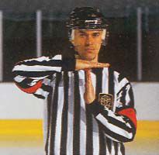
The 2014 IIHF Rule Book: The new lay out plus the principles of content & structure

Slide 9
2014 IIHF HOUSEKEEPING & MINOR RULE CHANGE SUMMARY

Slide 10
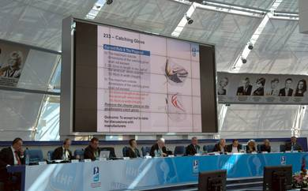
Housekeeping and Minor Rule Change Summary
The 51 housekeeping and minor rule change proposals were voted en bloc group during the recent IIHF Annual Congress following a 2 month review period provided to the IIHF membership
This included the following …

Slide 11
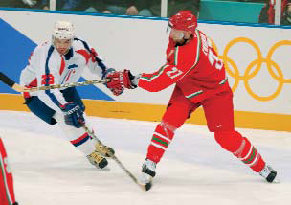
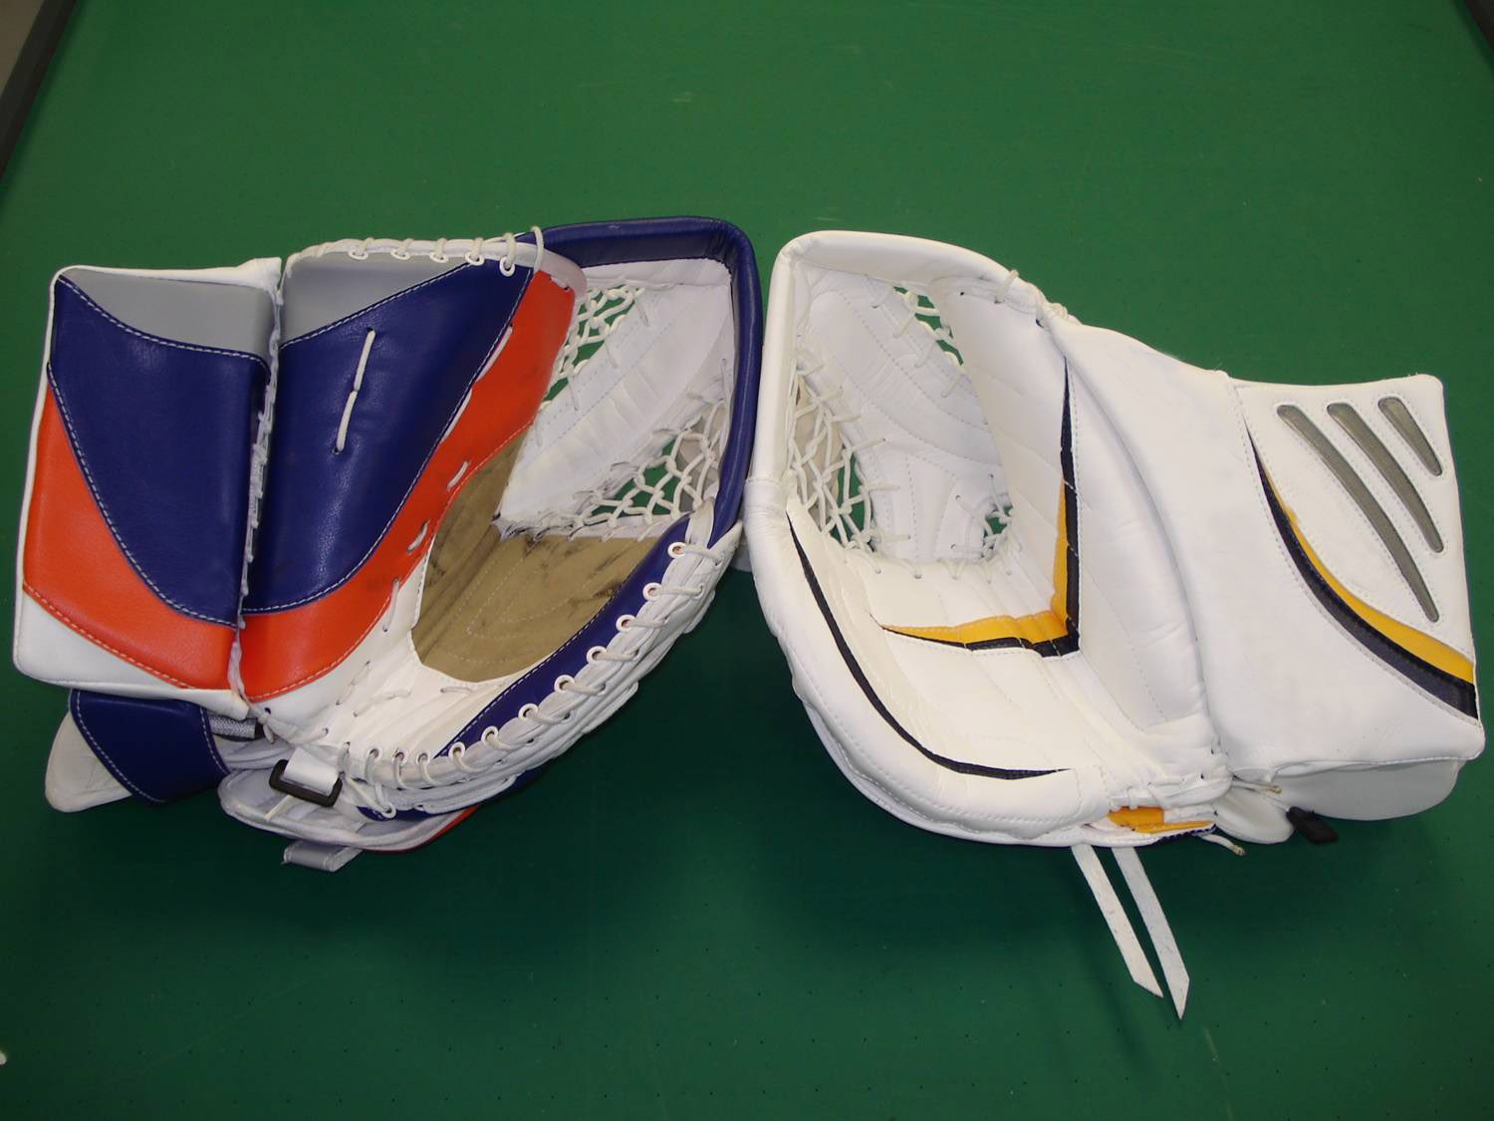
Rule Upgrades During the 2013/14 Season

Slide 12
Housekeeping and Minor Rule Change Summary
Procedures approved for removing ineligible players from a game in progress
Length of player stick for athletes over 2 metres in height was approved
One piece goaltender catching glove was approved
Goal Judges are no longer required when a operational Video Goal Judge System is in place
Clarification for application of Puck out of Bounds rule
Slew footing rule approved
Clarification for application of Abuse of Game Officials by Athletes & Team Officials rule
Removal of goaltender equipment sizes from the IIHF Rule book
Remove the term ‘altercation’ from the rule book
Clarifying body position on the Interference rule
Clarifying the Checking to the Head and Neck Area rule
Adoption of an Unsportmanlike Conduct Penalty
Clarification for the application of the Broken Stick rule
Clarification for awarding a goal when the goal net has been dislodged

Slide 13
Major Rule Change Overview
19 major rule change proposals were addressed at the Rules Congress held during the recent IIHF Annual Meeting in Minsk, Belarus
A special session was prepared and operated involving 64 member national associations in attendance under the direction of IIHF Vice President , Bob Nicholson, in a workshop format
Of the 19 proposals, 12 were rejected and 7 were adopted

Slide 14
2014 IIHF MAJOR RULE CHANGE SUMMARY

Slide 15
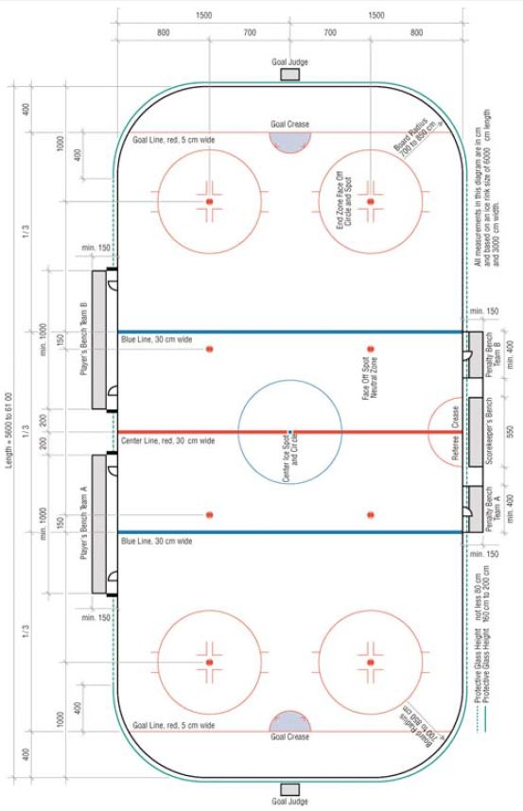
101 – Dimensions of the Rink
Current Rule & The New Rule
For IIHF competitions the size shall be 60 to 61 metres long and by 29 to 30 metres wide.
For IIHF competitions the dimensions are 60 metres long by 26 to 30 metres wide. The World Championship shall be 30 X 60. Other dimensions shall be subject to approval by the IIHF. Approved

Slide 16
102 – Boards
Current Rule & The New Rule
b) They shall be not less than 1.17 metres and not more than 1.22 metres in height above the level of the ice surface
b) They shall be 1070mm in height above the level of the ice surface. The height of the dasher boards shall be measured from the top of concrete slab (floor) to top of the top sill shall be 1100mm. Approved

Slide 17
105 – Protective Glass
Current Rule & The New Rule
a) The protective glass located above the boards shall be 160 cm to 200 cm in height on the ends and shall extend 4 metres from the goal line towards the neutral zone and not less than 80 cm in height along the side, except in front of the player benches
a) The protective shielding (spectator shielding) shall be an acrylic shielding system or equivalent system providing optimum flexibility without backlash effect in order to reduce risk of injury to the players.
b) The protective shielding located above the boards shall be 2400mm in height on the ends and shall extend 4m from the goal line towards the neutral zone and shall be 1800mm in height along the sides, except in front of the player benches.
d) No openings are allowed in the protective shielding with the exception of the hole in front of the Scorekeeper to allow him to speak with the Referee
Approved

Slide 18
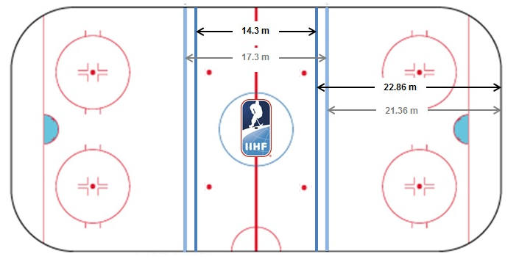
112 – Blue Lines
Current Rule & The New Rule
Increase the dimensions of the offensive/defensive zones to 22.86 metres from the end boards for consistency. Approved

Slide 19
411 – Change of Players and Goalkeepers
Current Rule & The New Rule
b) If, during a substitution, the player entering the game plays the puck of makes any physical contact with an opponent while the retiring player is actually on the ice, there shall be a Bench Minor penalty for Too Many Players on the Ice (Rule 573).
b) If, during a substitution, the player or players entering or leaving the game plays the puck or makes any physical contact with an opponent while the retiring player or players are on the ice, there shall be a Bench Minor penalty for Too Many Players on the Ice (Rule 573).
Approved

Slide 20
442 – Procedure for Conducting Face-Offs
Current Rule & The New Rule
c) The player of the attacking team in his attacking half of the rink shall place his stick on the ice first followed immediately by the player of the defending team.
c) The player of the defending team in his defending half of the rink shall place his stick on the ice first followed immediately by the player of the attacking team.
Approved

Slide 21
460 - Icing the Puck: Hybrid Icing
For the purpose of interpretation of the rule, there are two judgments required for "icing the puck".
1). The Linesman must first determine that the puck will cross the goal line. Once the Linesman determines that the puck will cross the goal line, icing is completed upon the determination as to which player (attacking or defending) would first touch the puck. This decision by the Linesman will be made by no later than the instant the first player reaches the end zone faceoff spots, with the player's skate being the determining factor.
2). Should the puck be shot down the ice in such a manner that it travels around the boards and/or back towards the end zone face-off spots, the same procedure shall be in effect in that the Linesman shall determine within a similar distance as to who will have touched the puck first. For clarification, the determining factor is which player would first touch the puck, not which player would first reach the end zone faceoff spots. If the race for the puck is too close to determine by the time the first players reaches the end zone face-off spots, icing shall be called.
Approved

Slide 22
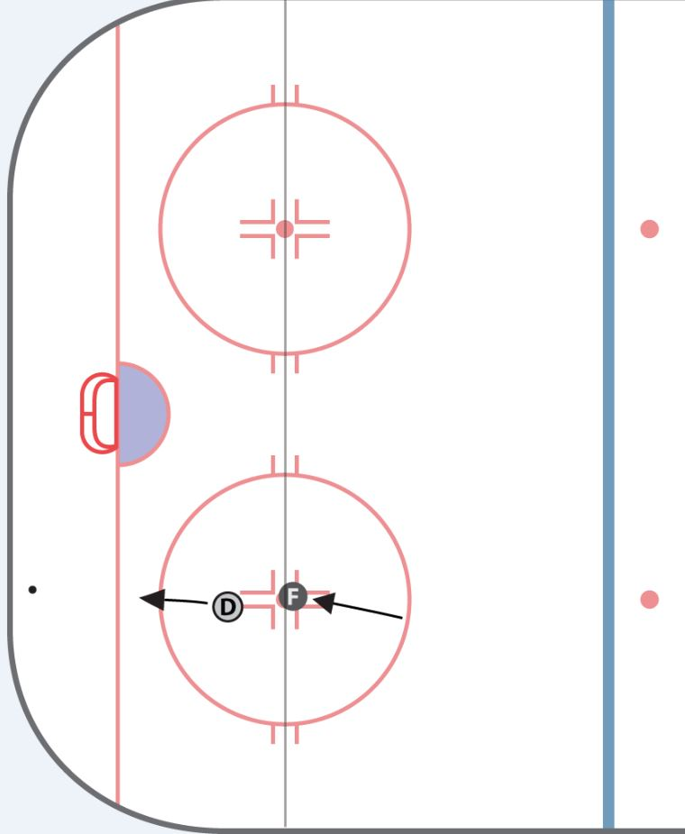
460 – Icing the Puck: Hybrid Icing #1
D
F

Slide 23
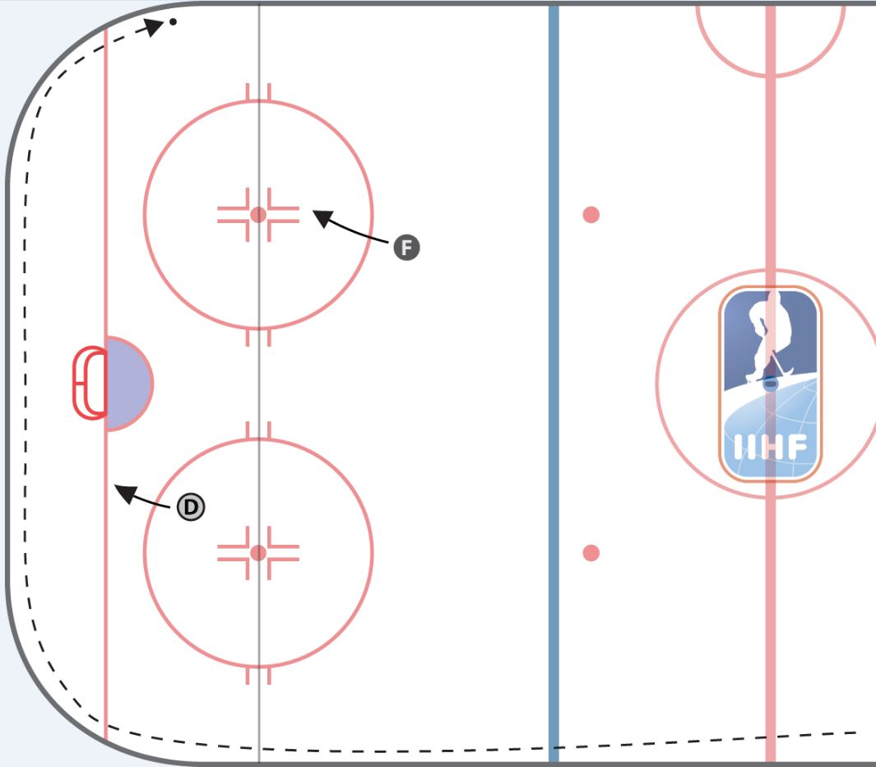
460 – Icing the Puck: Hybrid Icing #2

Slide 24
509 – Penalty Shot Procedure
Current Rule & The New Rule
Notes section of rule 509: 6. The “spin-o-rama” type of move where the player completes a 360° turn as he approaches the goal, shall be permitted as it involves continuous forward motion.
6. During the course of the Penalty Shot (PS) or Game Winning Shot (GWS) the “spin-o-rama” or lacrosse type of move where the player completes a 360° turn as he approaches the goal is not permitted. Approved

Slide 25
The 2014 IIHF Rule Book: Hybrid Icing

